Slide 1
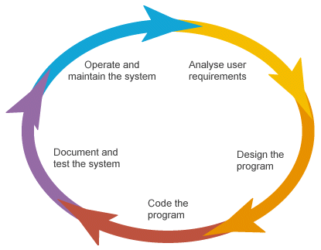
Advanced Software Engineering-MODULE 1
Notes:
‹#›

Slide 2

Contents
Introduction
Definition
Objectives
Software problems
Students projects Vs Industrial Software
Qualities of software
Notes:
‹#›

Slide 3
Reference text books
Software Engineering, a Practitioner’s Approach- Roger S Pressman 7th Edition, Tata Mc-Graw Hill Publishing Co. Ltd.
Software Engineering – Ian Somerville 9th Edition, Pearson Education
Jaya Vijayan

Slide 4
CO ASSESSMENT RUBRICS
Evaluation Criteria | CO
Written Assignment | MCA 203.1
CAE1 | MCA 203.1, MCA 203.2
CAE2 | MCA 203.3, MCA 203.4
Group Activity/Case Study/Presentation | MCA 203.4, MCA 203.5
Jaya Vijayan

Slide 5
Software Systems
Business
Scientific
Engineering
Simple
Complex
Internal – Payroll
Public – Railway reservation

Slide 6
Software Systems
ERP
Distributed
Information system
Mission Critical
Real Time

Slide 7

Successful software systems
Success rates less compared to other industries
Success
Development complete
It is useful, usable & Used

Slide 8

Origin of Term
Peter Naur et al coined the term “software engineering” at
NATO conference held in Europe in 1968 to discuss the growing
software crisis and the need to focus on software development.
Notes:
‹#›

Slide 9
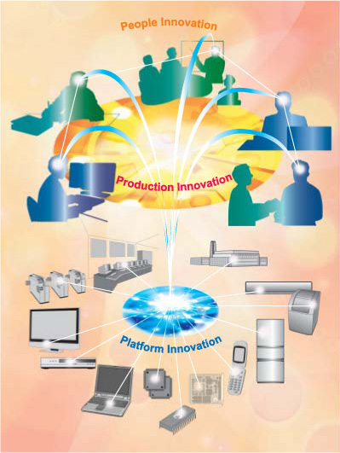
Definition
“Software Engineering is the systematic approach of conception , development , maintenance & retirement of Software”
Notes:
‹#›

Slide 10

Why Software Engineering?
Let us take an simple example of making a cup of Tea
Steps involved
Take water & milk in a vessel
Put it on to the gas & turn the gas on
Add sugar
When it boils add tea powder
Filter it and use
What about the taste?????
NO GUARENTTE….
Notes:
‹#›

Slide 11
Contd..
Guiding Principles for making Tasty tea
Ratio Of Milk and water
Amount of sugar & tea powder used.
Quality of milk and tea powder Etc..
The time we boil it etc..
Notes:
‹#›

Slide 12
Life cycle of a Software
Involves defining the problem, identifying its causes, specifying the solution, and identifying the information requirements that must be met by a system solution
Analysis
is the overall plan or model that shows how the system will meet its information requirements.
Design
Converting the design into codes using some programming languages
Coding
IS conducted to confirm that the system produces the right results
Testing & Implementation
After the product is delivered it is in the maintenance
Maintenance
Notes:
‹#›

Slide 13
Contd…
Following the phases you will get a software as output .
What about quality?????????? .
No guarentee……
There are certain principles and techniques which has to be applied to the phases which will lead to quality software .
All these guiding principles , techniques ,methodologies that is to followed makes the software engineering approach.
Notes:
‹#›

Slide 14
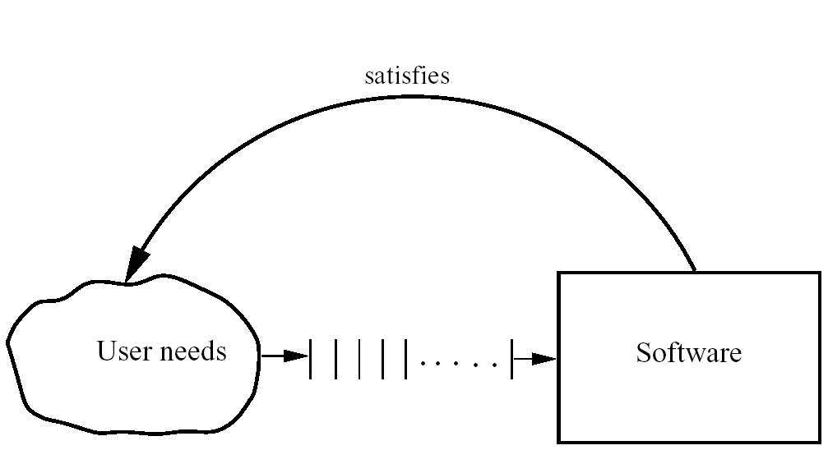
Basic Problem
Notes:
‹#›

Slide 15

Problem Domain
Software is Expensive
Late and unreliable
Maintenance And Rework
Notes:
‹#›

Slide 16
Contd..
Biggest problems in software development is
what is desired is not understood correctly.
Development proceeds when it is believed that requirements are generally in good shape.
As time passes the customer may find additional requirements which are not specified earlier
This leads to Rework.
Notes:
‹#›

Slide 17
REWORK
Reason Contributing to Rework
Changes in
Customers needs
Business environment
Technology
It is estimated that of the total development effort 30 to 40% of effort is spend on rework

Slide 18
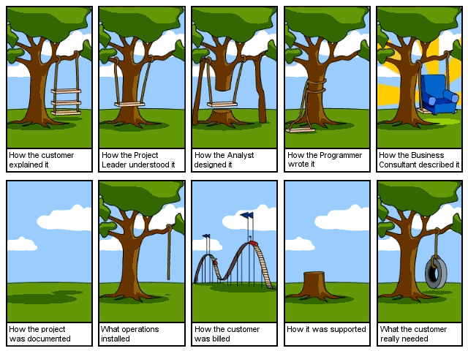
Practical Problems in software development
Notes:
‹#›

Slide 19
Students Projects Vs Industrial Projects
2 different scenarios here
You are given a problem for which you have to build a software system say in C or Java which is around 10,000 LOC what is the time period required?
Most of the students will say 1 to 3 months, there is also a chance of you completing it in 2 months.
Notes:
‹#›

Slide 20
Contd…
With 2 months as completion time productivity will be 5000 lines of code per person-month
Now we will consider the industry scenario.
In industry it is fair to say that a productivity figure of 1000 LOC per person per month is quite respectable.
Why this difference??
Notes:
‹#›

Slide 21
Contd…
Why is it that the students seem to be more productive in their students days than they become professionals?????
Answer is that 2 different things are being built in two different scenario.
A student system is built whose main purpose is to demo that it works.
Notes:
‹#›

Slide 22
Contd..
An industrial software is built by a team of professionals in an organization for a client who is paying for it & whose business may depend on proper working of the system.
In the latter case the software engineering principles are applied.
Notes:
‹#›

Slide 23

Contents
Important Qualities Of software Product
Software Engineering Principles
Introduction to process models
Different Process Model
Notes:
‹#›

Slide 24

Qualities of a software
Correctness- Correctness of the software is the extent to which it satisfies it’s functions specifications.
Reliability- Reliability is the probability that software will operate as expected over a specified time interval.
Notes:
‹#›

Slide 25
Qualities of a software
Robustness- Software is robust if it behaves reasonably even under unanticipated circumstances.

Slide 26
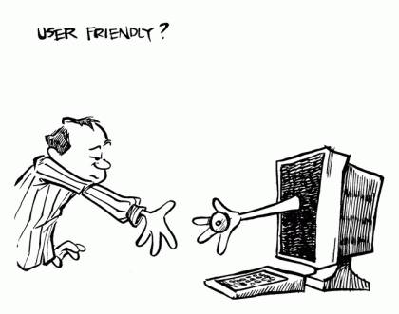
Contd..
User Friendly – It is the measure of an effort required to configure , install , learn and use the software .
It is measured in terms of
ease of use
response time
correctness of results Etc..
Notes:
‹#›

Slide 27

Contd..
Maintainability –it is an effort required to locate and fix errors in operating software.
It includes both corrective maintenance and adaptive maintenance.
Notes:
‹#›

Slide 28

Contd..
Reusability-It is an extent to which parts of the software can be re-used in other related applications.
Portability- Software is portable if it can run in different hardware or software platforms.
It is an ability to run software on different platforms.
Notes:
‹#›

Slide 29
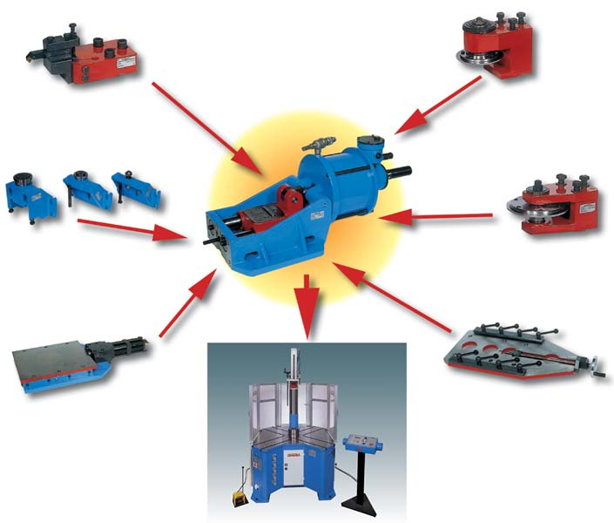
Contd..
Modularity – A system that is composed of modules is called modular systems.
Three advantages of using modular systems are
1.Decomposition-Decomposing a complex system into pieces , apply divide & isolate then conquer strategy .
2.Composibility-First develop the components required , then assemble the finished product
3.Understandable-Modularity also aid in easy understanding of the system.
Notes:
‹#›

Slide 30
Software Engineering approach
The three main factors on which the Q&P (Quality & Productivity) of the project depend are the people , process and technology , called as the Iron triangle.
Quality &
Productivity
Technology
People
Process
Notes:
‹#›

Slide 31

Principles of Software engineering
Software Engineering principles are based on the observation of thousands of projects.
Following are the principles.
Make quality the number one objective.
Give products for customers early
Determine the problem
Evaluate design alternatives
Use an Appropriate process model
Minimize the intellectual distance between the developer and the user-intellectual
Good Management is better than good technology
People are key to success
Follow with care
Notes:
‹#›

Slide 32
The Software Process
A process is a collection of activities, actions, and tasks that are performed when some work product is to be created
A generic process framework for software engineering encompasses five activities.
Communication.
Planning
Modeling
Construction
Deployment
Notes:
‹#›

Slide 33
The Software Process
Software engineering process framework activities are complemented by a number of umbrella activities.
In general, umbrella activities are applied throughout a software project and help a software team manage and control progress, quality, change, and risk.
Notes:
‹#›

Slide 34
The Software Process
Typical umbrella activities include:
Software project tracking and control.
Risk management
Software quality assurance
Technical reviews
Measurement
Software configuration management
Reusability management
Work product preparation and production
Notes:
‹#›

Slide 35
Process Models
The process that deals with the technical and management issues of software development is called a software process.
A successful project is the one that satisfies the expectations on all the three goals cost, schedule and quality.
What is a process model?
“A process model specifies a general process , usually as a set of stages in which a project should be divided, the order in which the stages should be executed , and any other constraints and conditions on the execution of the stages”
Notes:
‹#›

Slide 36
Process models Contd..
A process is a means to reach the goals of high quality , low cost ,and low cycle time , and a process model provides generic guidelines for developing a suitable process for a project.
Uses of process models
To organize, plan, staff, budget , schedule and manage software projects.
To determine which software engineering tools and methodologies will be most appropriate.
Notes:
‹#›

Slide 37
Process models Contd..
As a framework for analyzing and estimating patterns of resource allocation and consumption during software life cycle.
Notes:
‹#›

Slide 38
Process models Contd..
Prescription Process Model
The waterfall model
Incremental Model ( iterative enhancement model)
V model …
Evolutionary Process model
Prototyping
Spiral
Notes:
‹#›

Slide 39



The Waterfall Development Process
Notes:
*
*07/16/96
(c) 2007 National Academy for Software Development - http://academy.devbg.org. All rights reserved. Unauthorized copying or re-distribution is strictly prohibited.*
‹#›##

Slide 40
Waterfall Model
The waterfall model is a software development model first proposed in 1970 by W. W. Royce, in which development is seen as flowing steadily through the phases of
Requirements analysis
Design
Coding
Testing (validation)
Implementation
Maintenance
It is the simplest process model which states that phases are arranged in linear order.
It is well suited for routine type projects where all requirements are well understood
Notes:
‹#›

Slide 41
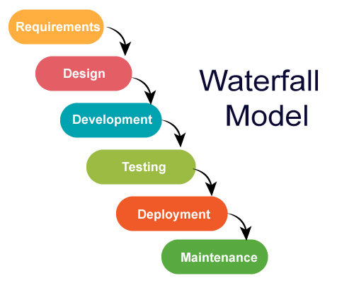
Notes:
‹#›

Slide 42
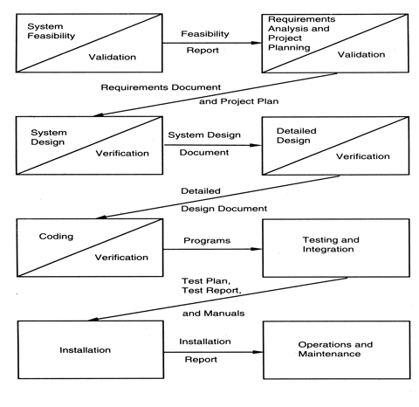
Waterfall model
Notes:
‹#›

Slide 43

Verification & Validation
Verification:
Are we building the product right?
Validation:
Are we building the right product?
Notes:
‹#›

Slide 44

Documents produced in waterfall model
Minimum set of documents that must be produced in waterfall model
Requirements document
Project plan
System design document
Detailed design document
Test plan and test reports
Final code
Software manuals ie. User manual , installation manual etc..
Review reports
Notes:
‹#›

Slide 45
Advantages Vs Limitations
ADVANTAGES | LIMITATIONS
Good progress tracking due to clear development stages. | It assumes that requirements of a system can be frozen before the design begins. This is suitable for automating the existing manual system for which all requirements are known before design starts.
Milestones and deliverables can be clearly identified | Freezing requirements usually requires choosing of hardware. If project takes long time for completion , the hardware for which it was developed may become obsolete
Project Management and control is facilitated by the need to complete each stage before moving to the next.

Slide 46
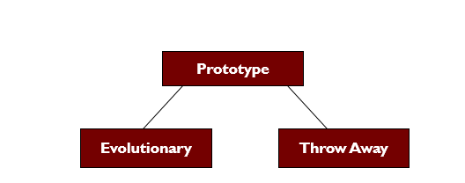
Prototype model
The goal of prototype model is to counter the first two limitations of the waterfall model.
Prototyping is of 2 types

Slide 47
Prototype model
The basic idea here is that instead of freezing the requirements before design & coding, a throwaway prototype is built which help to understand the requirements.
This prototype is built based on the currently known requirements.
Development of the prototype obviously undergoes design, coding and testing .

Slide 48
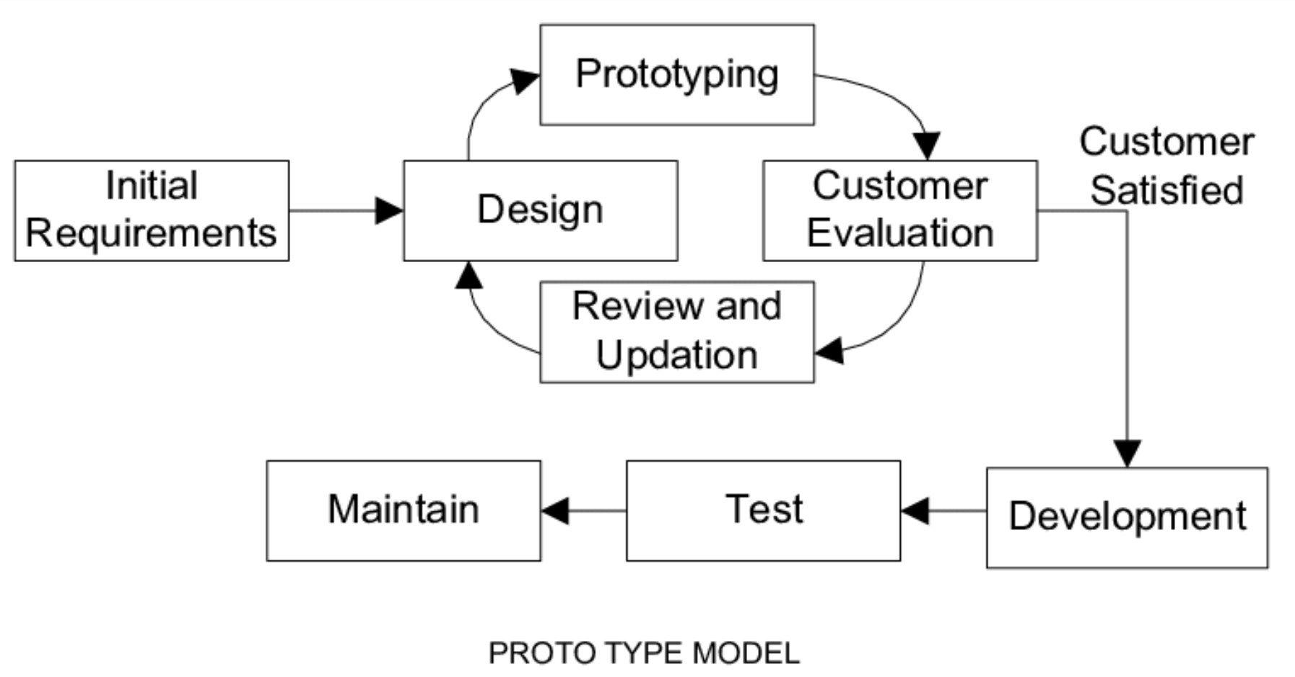
Prototype model
Notes:
‹#›

Slide 49
Prototype model
But these phases are not done very formally or thoroughly
By using prototyping the client can get an actual feel of the system, because the interactions with the prototype can enable the client to better understand the requirements of the desired system.

Slide 50
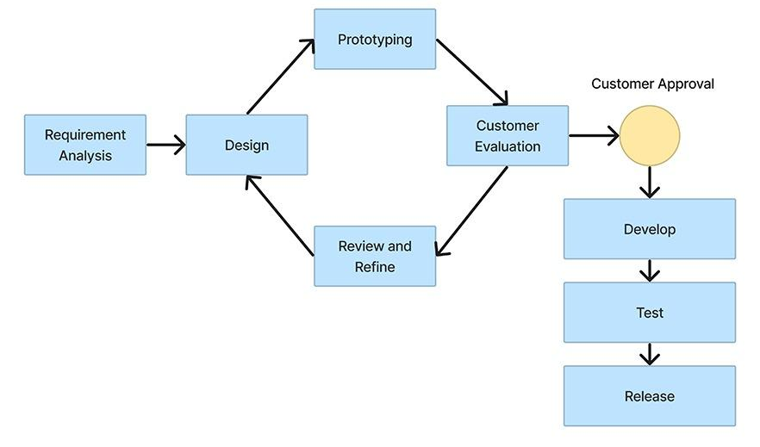
Prototype model diagram

Slide 51
Prototype model
Prototyping begins with requirements gathering .
Developer and customer meets and define the overall objectives , identify the areas which are not clear.
Then a quick and throwaway prototype satisfying the know requirements are built.
The users are allowed to work with the prototype

Slide 52
Prototype model contd..
They provide feedback like
what is correct
Areas to be modified
Features to be added
Unwanted features

Slide 53
Prototype model contd..
Based on this feedback the prototype is modified to incorporate the required changes and then clients are allowed to work on the new version of the prototype.
This cycle continues until no more changes are required.
Then the final requirements are refined and the product is developed.
Ideally prototype serves as a mechanism for identifying the requirements
It is well suited for projects where the requirements are hard to determine.
It is an excellent technique for reducing risk associated with the project.

Slide 54
Problematic areas of prototyping model
There are chances of giving less importance for software quality and maintainability , as prototype model gives prime importance for the quick workable prototype of the system.
Developer can make the less-than-ideal choice of algorithms and operating system for the purpose of getting quick workable prototype.
Later he may forget to make them efficient.

Slide 55
Why prototyping is cost effective??
Experience of developing prototype reduces the cost of later phases of the product development.
Requirements obtained after having the working experience with the prototype tends to be more stable.
Because the clients and developer gets involved in refining the system, the final system developed will be more closer to the actual requirements.

Slide 56

Iterative Enhancement Model
This model tries to combine the benefits of both waterfall and prototyping model.
Basic idea is that the software should be developed in increments.
Each increment adding some functional capability to the system until full system is implemented.
Notes:
‹#›

Slide 57
Iterative Enhancement Model Figure
Design0 Design1 Design n
Implement0 Implement1 --- Implement n
analysis0 analysis1 analysis n
Notes:
‹#›

Slide 58
Iterative Enhancement Model Contd..
It can result in better testing because testing in increment is likely to be easier than testing the entire system as in waterfall model.
Further as in prototyping , the increments provide feedback to the client that is useful for determining the final requirements of the system.
Notes:
‹#›

Slide 59

Iterative Enhancement Model Contd..
First increment is often a core product.
Basic requirements are addressed , but many supplementary features remain undelivered.
The core product is used by the customer.
From the feedback the product is modified with additional features and functionality and next increment is released.
This process is repeated following each increment until complete product is ready.
This model focuses on the delivery of an operational product with each increment.
Notes:
‹#›

Slide 60
ADVANTAGES | DISADVANTAGES
Delivers an operational quality product at each stage, but one that satisfies only a subset of the clients requirements | Each additional build has somehow to be incorporated into the existing structure without degrading the quality of what has been build to date.
A relative small number of programmers/developers may be used | Addition of succeeding builds must be easy and straightforward
From the delivery of the first build, the client is able to perform useful work | The more the succeeding builds are the source of unexpected problems, the more the existing structure has to be reorganized, leading to inefficiency and degrading internal quality and degrading maintainability
Notes:
‹#›

Slide 61
ADVANTAGES | DISADVANTAGES
Reduces the traumatic effect of imposing a completely new product on the client organization by providing a gradual introduction | Clients see possibilities and want to change requirements.
There is a working system at all times
Clients can see the system and provide feedback
Progress is visible, rather than being buried in documents
Notes:
‹#›

Slide 62
When it is to be used?
It is useful for product development in which developers themselves provide specification.
It is useful if the core of the application is well understood and increments can be easily defined and negotiated.
It is useful when staffing is unavailable for a complete implementation by the business deadline that has been established for the project.
Notes:
‹#›

Slide 63
Contd..
Early increments can be implemented with fewer people . If core product is well received , then additional staff can be added to implement the next increment.
Notes:
‹#›

Slide 64

Spiral Model
Developed by Barry Boehm in the mid '80s
The major distinguishing feature of the Spiral Model is that it creates a risk-driven approach to the software process rather than a primarily document-driven or code-driven process
Prof. Barry Boehm

Slide 65
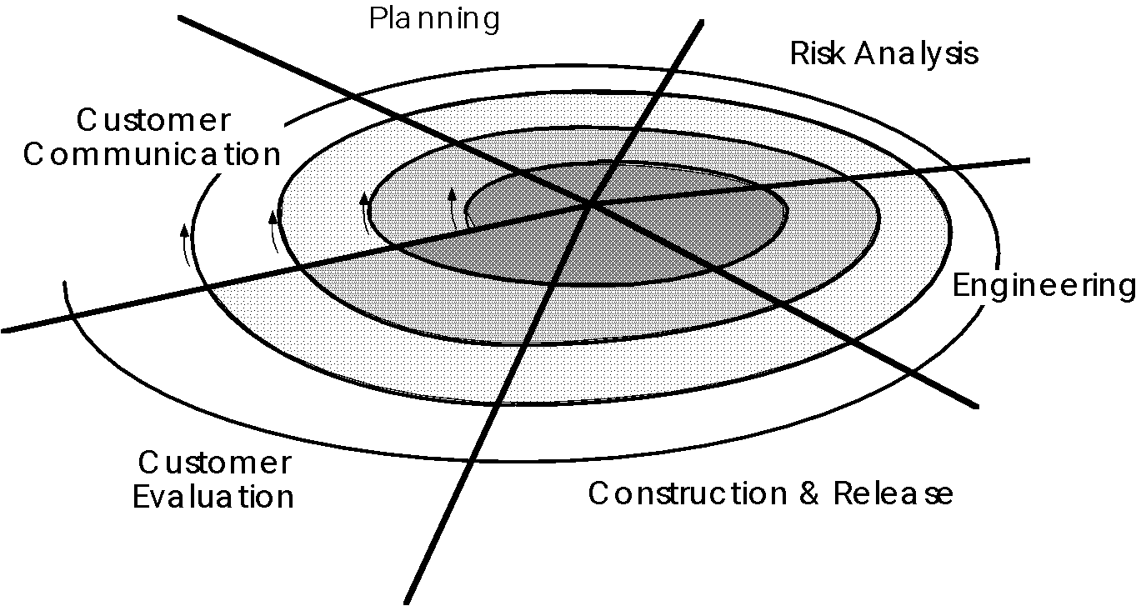
The spiral model

Slide 66
Spiral Model Contd..
The Spiral Model was designed to include the best features from the Waterfall and Prototyping Models, and introduces a new component - risk-assessment.
The term "spiral" is used to describe the process that is followed as the development of the system takes place.
Similar to the Prototyping Model, an initial version of the system is developed, and then repetitively modified based on input received from customer evaluations.

Slide 67
Spiral Model Contd..
Unlike the Prototyping Model, however, the development of each version of the system is carefully designed using the steps involved in the Waterfall Model.
With each iteration around the spiral (beginning at the center and working outward), progressively more complete versions of the system are built.

Slide 68
Spiral Model Contd..
Risk assessment is included as a step in the development process as a means of evaluating each version of the system to determine whether or not development should continue.
If the customer decides that any identified risks are too great, the project may be halted.

Slide 69
6 Task Regions
Customer communication – to establish effective communication between developer and customer.
Planning – to define resources, time lines and other project related information..
Risk analysis – to assess both technical and management risks.
Engineering – to build one or more representations of the application.

Slide 70
Contd…
Construction and release – to construct, test, install and provide user support (e.g., documentation and training).
Customer evaluation – to obtain customer feedback based on the evaluation of the software representation created during the engineering stage and implemented during the install stage.

Slide 71
Advantages
It has strong support for Risk Analysis.
It is well suited for complex and large projects.
The deliverable is produced early in the software development life cycle.
It uses prototyping as a risk reduction technique and can reduce risks in the SDLC process considerably.

Slide 72
Disadvantages
It is high in cost and Risk Analysis is also very difficult.
It is not suited for small projects.
Needs considerable Risk Assessment.

Slide 73
Application area
Boehm's model has become quite popular among ADE (Aerospace, Defense and Engineering) specialists, and is not so familiar among business developers. ... It is particularly useful in ADE projects, because they are risky in nature.

Slide 74

How to select the process model
Which model should WE choose???
The right type of the Model should be chosen for the project.
This depends on a number of factors
Some of which are given below.
The Scope of the Project
The Project Budget
The organizational environment
Available Resources

Slide 75
Comparison of process models
Strengths | Weaknesses | Types of projects
Waterfall Simple. Easy to execute. Intuitive & Logical. | Requirements frozen early. Disallows changes. Cycle time too long. May choose outdated hardware technology. User feedback not allowed. | For well understood problems , short duration project . Automation of existing manual systems.
Prototyping Helps in req. elicitation. Reduces risks. Leads to a better system. | Disallows later changes. | Systems with novice users . When uncertainties in requirements. When UI is important

Slide 76
Contd…
Strengths | Weaknesses | Types of projects
Iterative Prioritizes requirements. Reduces risks. Accommodates changes. Allows used feedback. | Cost may increase as work done in one iteration may have to be undone later. | Where risk of a long project cannot be taken. Where requirements are not known and will be known only with time.
Spiral Reduces risk | Costlier compared to other models. | Where risk is high.

Slide 77
V- Model –SELF Study

Slide 78
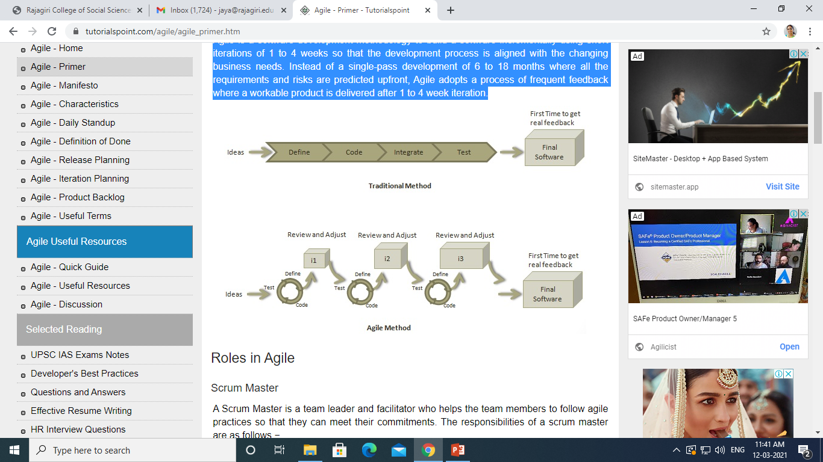
AGILE
Agile is a software development methodology to build a software incrementally using short iterations of 1 to 4 weeks so that the development process is aligned with the changing business needs.
Instead of a single-pass development of 6 to 18 months where all the requirements and risks are predicted upfront, Agile adopts a process of frequent feedback where a workable product is delivered after 1 to 4 week iteration.

Slide 79
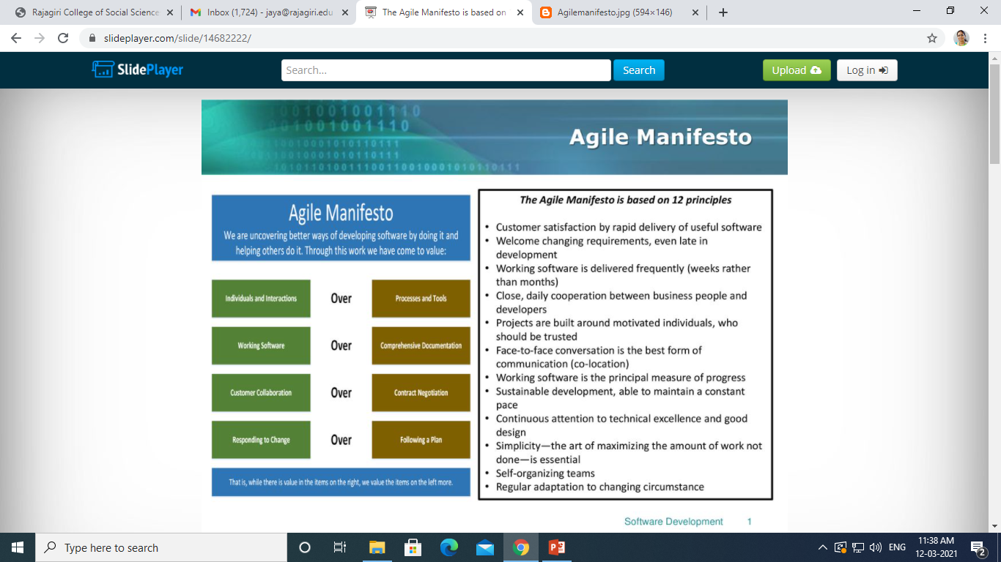
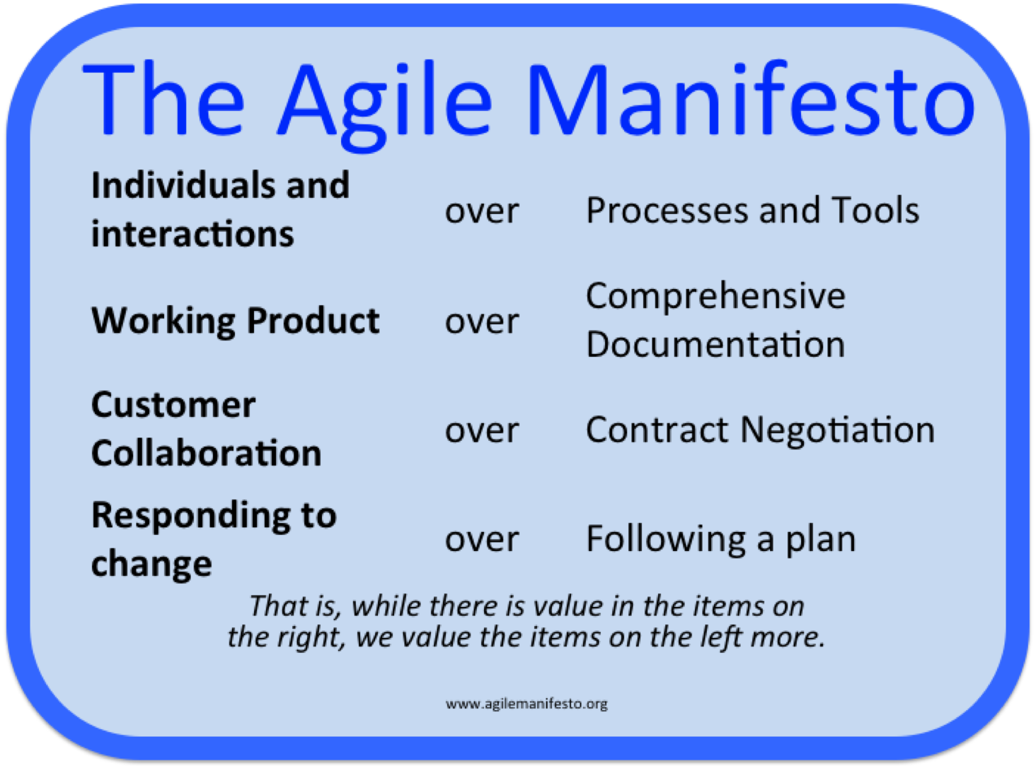

Slide 80
Agile Characteristics
Iterative/incremental and Ready to Evolve
Face-to-face Communication
Feedback Loop

Slide 81
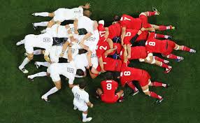
What is Scrum?
Definition from rugby football:
A scrum is a way to restart the game after an interruption, where the forwards of each side come together in a tight formation and struggle to gain possession of the ball when it is tossed in among them
Notes:
‹#›

Slide 82
Scrum - an agile process
SCRUM is an agile, lightweight process for managing and controlling software and product development in rapidly changing environments.
Iterative, incremental process
Team-based approach
developing systems/ products with rapidly changing requirements
Controls the chaos of conflicting interest and needs
Improve communication and maximize cooperation
Protecting the team form disruptions and impediments
A way to maximize productivity
Notes:
‹#›

Slide 83
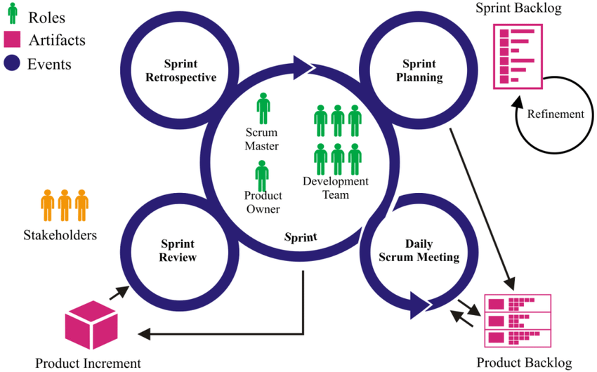
COMPONENTS OF SCRUM
SCRUM ROLES
Scrum Master
Typically filled by a Project Manager or Team Leader
Main job is to remove impediments
Notes:
‹#›

Slide 84
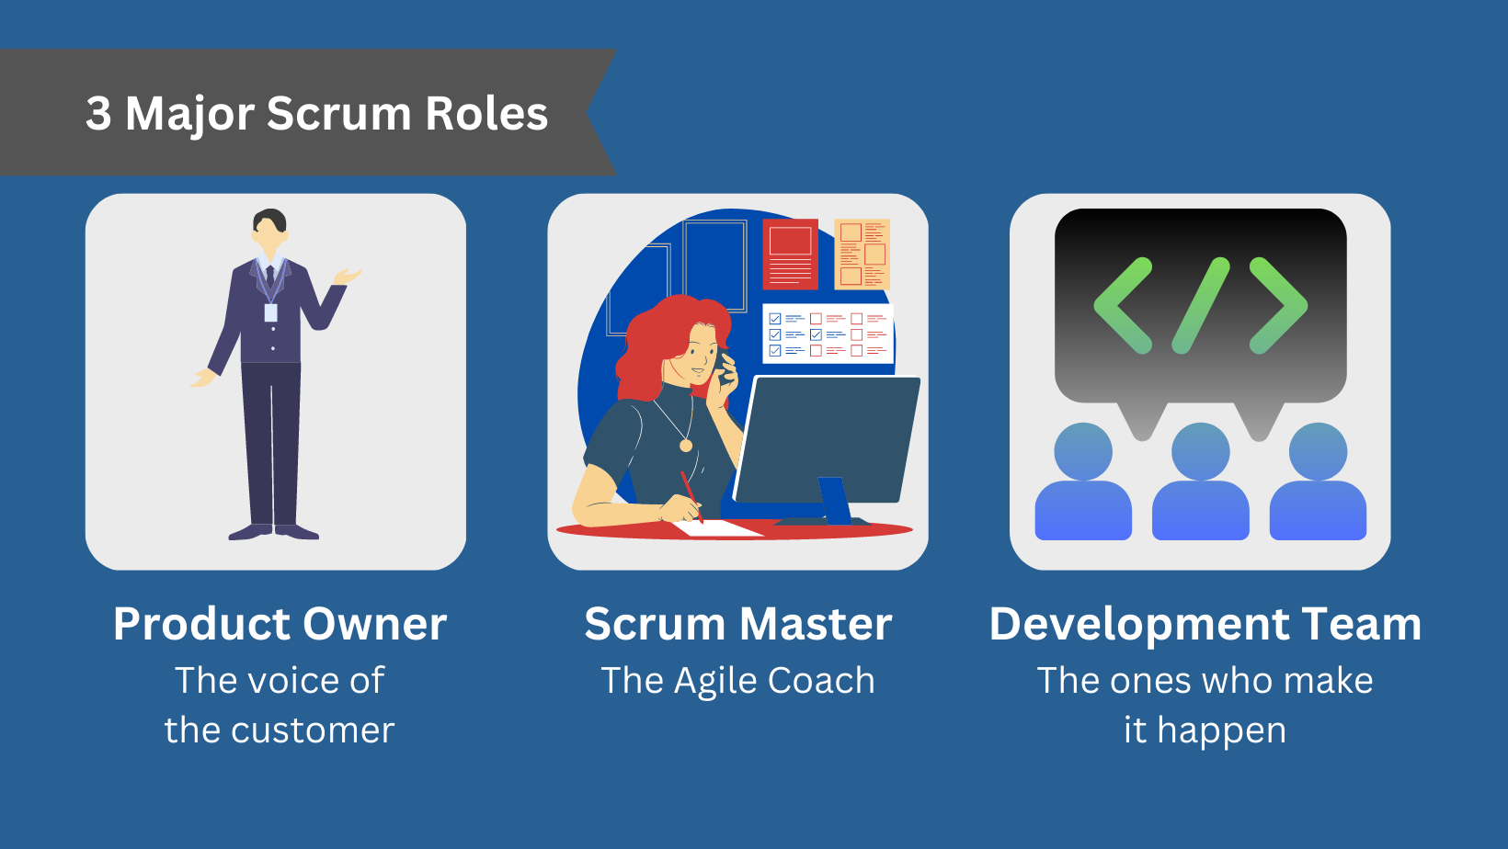
COMPONENTS OF SCRUM
SCRUM ROLES
The Scrum Team
Typically 5-10 people
Cross-functional (QA, Programmers, UI Designers, etc.)
Notes:
‹#›

Slide 85
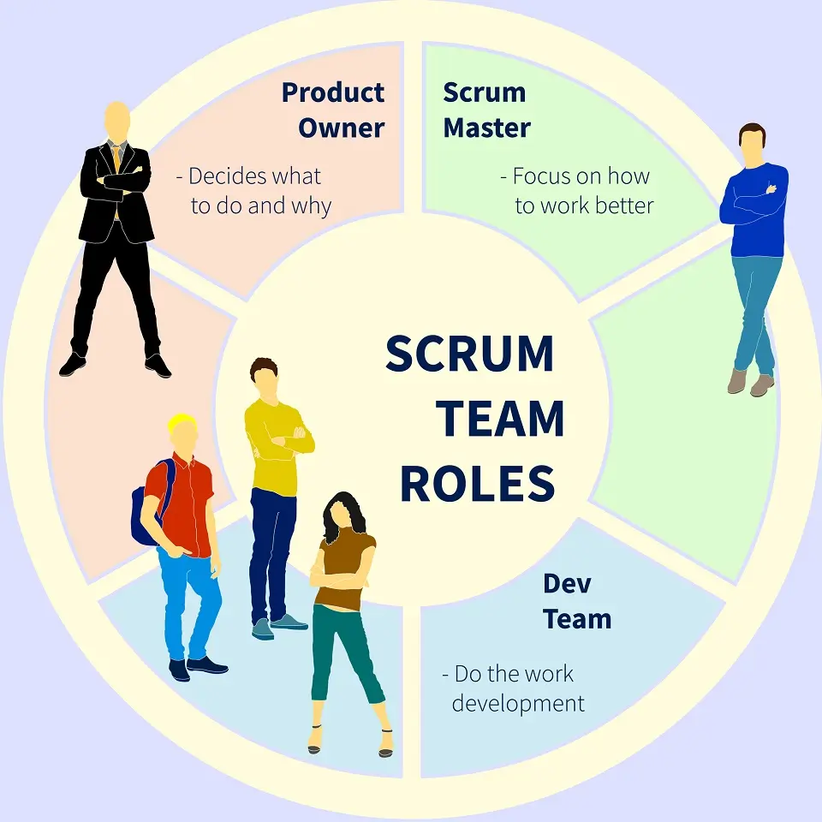
COMPONENTS OF SCRUM
SCRUM ROLES
Product Owner
Typically a product manager
Notes:
‹#›

Slide 86
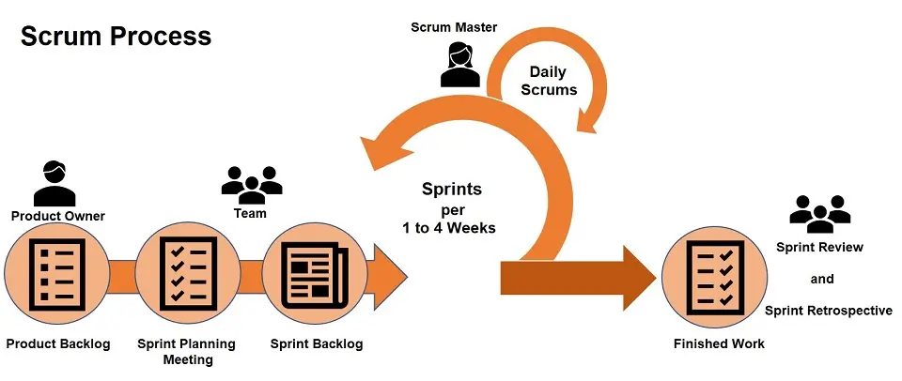
COMPONENTS OF SCRUM-The Process
Sprint Planning Meeting
Sprint
Daily Scrum
Sprint Review Meeting

Slide 87
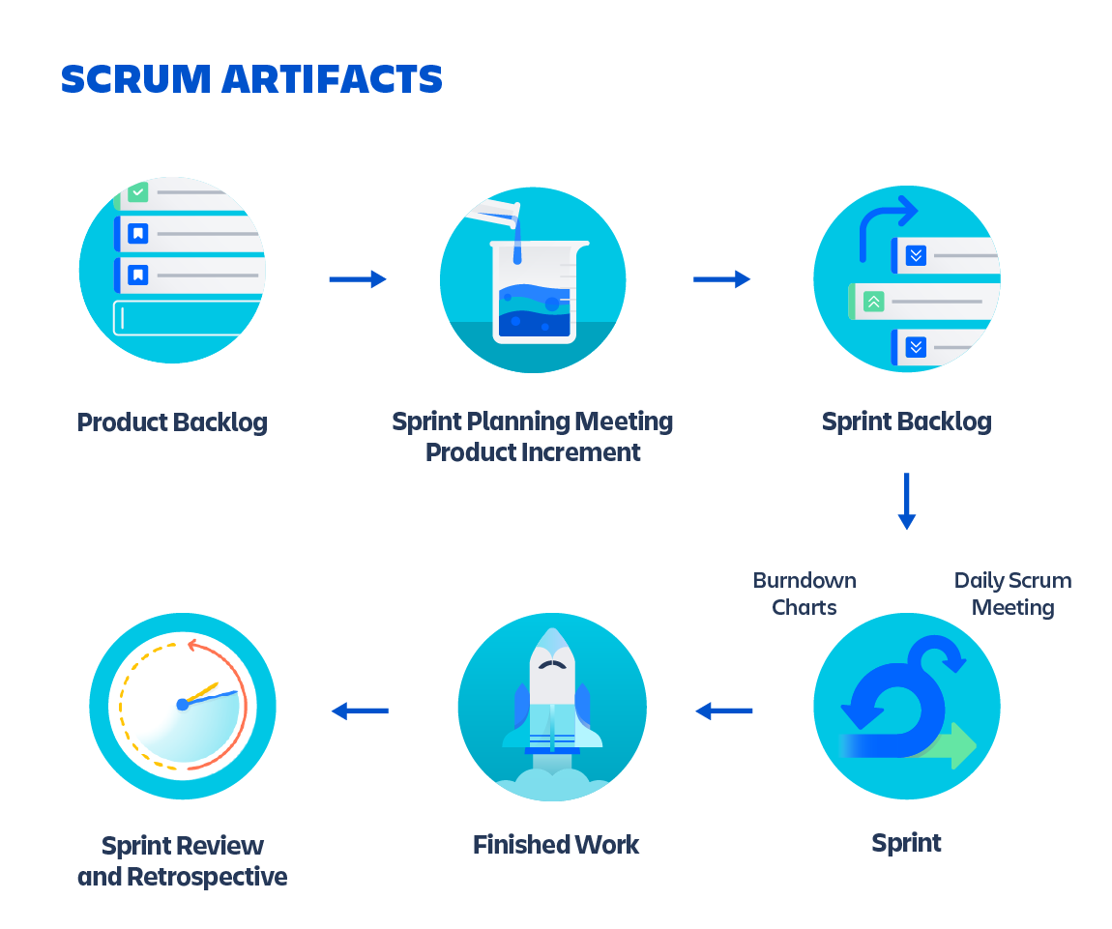
COMPONENTS OF SCRUM
SCRUM ARTIFACTS
Product Backlog
Sprint Backlog
Burn down Charts
Notes:
‹#›

Slide 88
Characteristics of Product Backlog
Each product should have one product backlog which can have a set of large to very large features.
Multiple teams can work on a single product backlog.
Ranking of features is done based on business value, technical value, risk management or strategic fitness.
Highest ranking items are decomposed into smaller stories during release planning so that they can be completed in future iterations.

Slide 89
sprint backlog
Sprint backlog is the set of items that a cross-functional product team selects from its product backlog to work on during the upcoming sprint.
Typically the team will agree on these items during its sprint planning session. In fact, the sprint backlog represents the primary output of sprint planning.

Slide 90
Burndown chart
A burndown chart shows the amount of work that has been completed in an epic or sprint, and the total work remaining.
Burndown charts are used to predict your team's likelihood of completing their work in the time available.

Slide 91
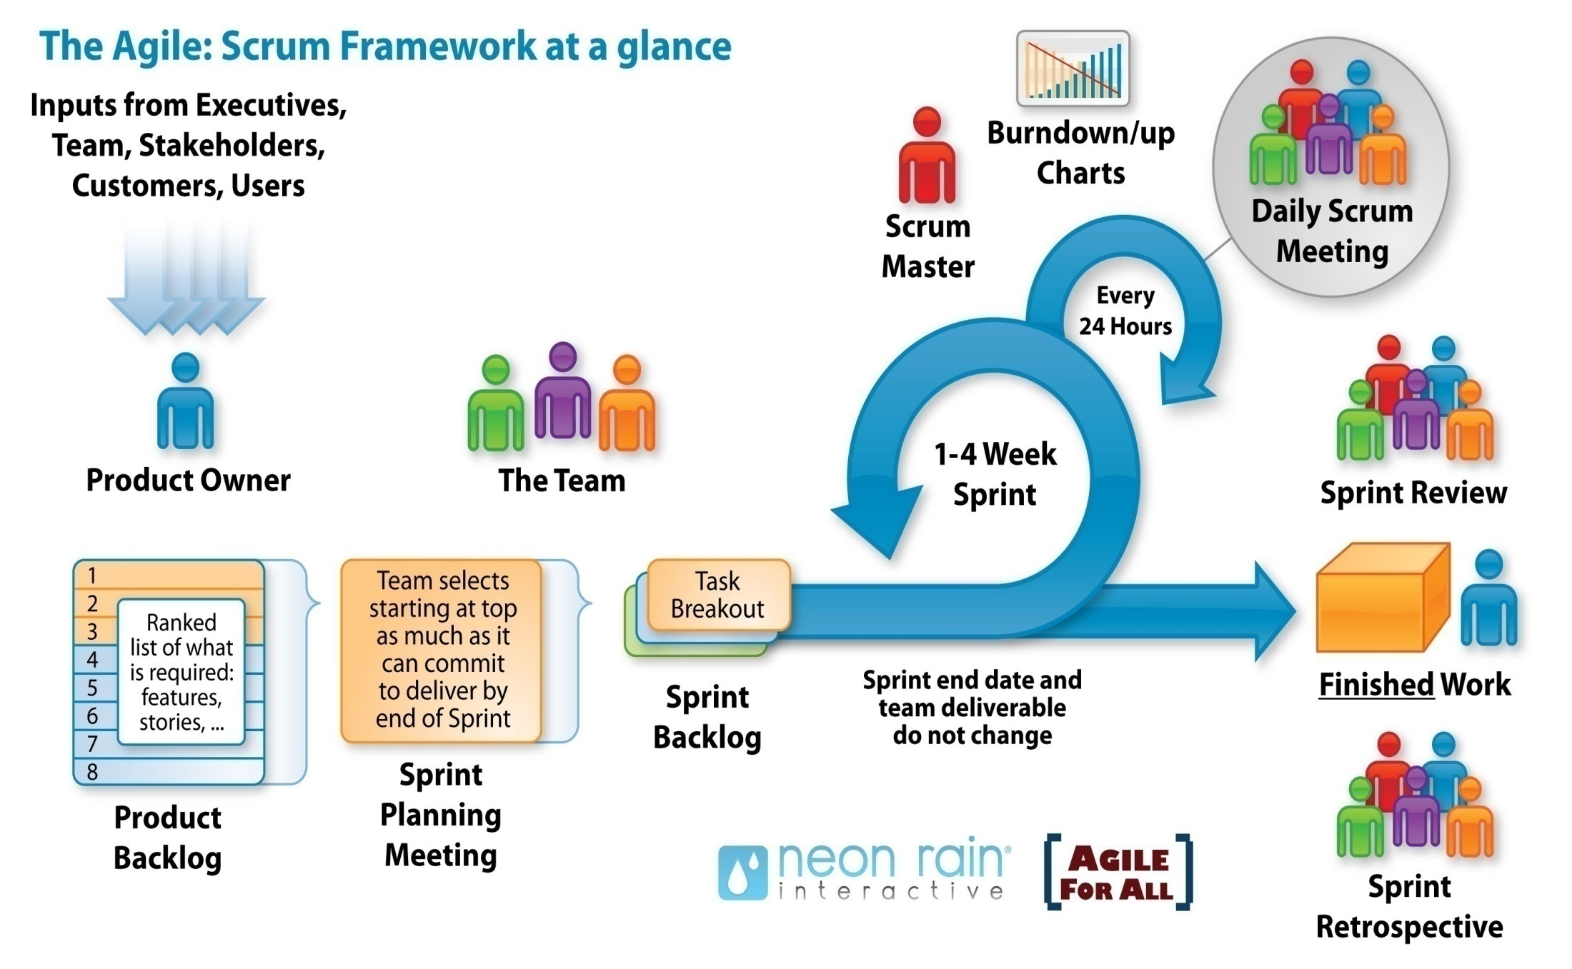
How does it work
Notes:
‹#›

Slide 92
What is Daily Stand-up?
A daily stand-up is a daily status meeting among all team members and it is held roughly for 15 minutes.
Every member has to answer three important questions −
What I did yesterday?
What I'll do today?
Any impediment I am facing.../ I am blocked due to...
Daily stand-up is for status update, not for any discussion. For discussion, team members should schedule another meeting at a different time.
Participants usually stand instead of sitting so that the meeting gets over quickly.

Slide 93
Definition of Done
The Definition of Done is an agreed-upon set of items that must be completed before a project or user story can be considered complete. It is applied consistently and serves as an official gate separating things from being “in progress” to “done.”
While the particulars vary from organization to organization, a typical definition of done consists of a checklist containing items such as:
Code is peer-reviewed
Code is checked in
Code is deployed to test environment
Code/feature passes regression testing
Code/feature passes smoke testing
Code is documented

Slide 94
Definition of Done
Help documentation is updated
Feature is OK’d by stakeholders
Different companies and development groups will come up with their own variant, but they all tack back to the same ideal: the code does what it’s supposed to and doesn’t break anything else. Making every feature/release/sprint go through these steps to ensure done-ness is important most of all to ensure consistent quality and completeness.
There should also be an element of transparency since everything can be tied back to that done-ness checklist. If a release or feature hasn’t checked off all the boxes, then it can’t move forward and everyone knows why.

Slide 95
Release
A release is a major milestone that represents an internal or external delivery of working, tested version of the product/system. A release is done when
System is stress tested.
Performance is tuned.
Security validations are carried out.
Disaster recovery plan is tested.

Slide 96
Release planning
The prerequisites of release planning are as follows −
A ranked product backlog, managed by the Product Owner. Generally five to ten features are taken which the product owner feels that can be included in a release
Team's input about capabilities, known velocity or about any technical challenge
High-level vision
Market and Business objective
Acknowledgement whether new product backlog items are needed

Slide 97
Output
The output of a release planning can be the following −
Release plan
Commitment
Issues, concerns, dependencies, and assumptions which are to be monitored
Suggestions to improve future release plannings

Slide 98
Iteration Planning
Prerequisites of Planning
Items in product backlog are sized and have a relative story point assigned.
Ranking has been given to portfolio items by the product owner.
Acceptance criteria has been clearly stated for each portfolio item.

Slide 99
Planning Process
Following are the steps involved in iteration planning −
Determine how many stories can fit in an iteration.
Break these stories into tasks and assign each task to their owners.
Each task is given estimates in hours.
These estimates help team members to check how many task hours each member have for the iteration.
Team members are assigned tasks considering their velocity or capacity so that they are not overburdened.

Slide 100
THANK YOU

